Slide 1

Dr Mahalingam College of Engineering & Technology
Department of Computer Science and Engineering Project Viva Voce
Third Review
Team Number: 19BCSB18
Domain: Recommendation System [Data Mining]
Title: Crop Recommendation System using Neural Networks
Guide : J.Bhavithra (AP/CSE)
Team Members: M.Sneaha 15BCS076
M.Susilkumar 15BCS094
A.Vignesh 16BCS316
Date: 14/07/2018

Slide 2
Contents
Objective
Problem Statement
Literature Identified and Findings
Existing System with Block Diagram
Proposed System with Block Diagram
Module Description
Software and Hardware Requirements
Results and Discussion
Screen Shots
Future Work
References
Online Certification Courses

Slide 3
Objective:
The following are the objectives of our proposed idea
To develop a network of clusters using various attributes.
To develop a mining algorithm for analyzing crops and soil factors.
Result from mining will be used to provide recommendation of crops in future.
Crops can thus be cultivated on rotation basis with maximum yield.

Slide 4
Problem Statement:
To improve agriculture the various factors will be made into consideration and the results from them will provide recommendation.

Slide 5
Literature Identified and Findings
Aitkin, M. and Foxall, R. (2003). Statistical modelling of artificial neural networks using multi-layer perceptron. Statistics and Computing 13, 227–239.MathSciNetCrossRefGoogle Scholar
Alon, I., Qi, M. and Sadowski, R.J. (2001). Forecasting aggregate retail sales: a comparison of artificial neural networks and traditional methods. Journal of Retailer and Consumer Services 8, 147–156.CrossRefGoogle Scholar
Anders, U. and Korn, 0. (1999). Model selection in neural networks. Neural Networks 12, 309–323.CrossRefGoogle Scholar
Barat, C., Loaiza, H., Colle, E. and Lelandais, S. (2000). Neural and statistical classifiers. Can such approaches be complementary? In: Instrumentation and Measurement Technology Conference, Vol. 3, pp. 1480–1486.Google Scholar
Bastos Cavalcante, R. and Ludemir, T.B. (2001). Design of neural networks for time series prediction using case-initialized genetic algorithms. In: Proceedings 8th International Conference on Neural Information Processing, pp. 382–387.Google Scholar

Slide 6
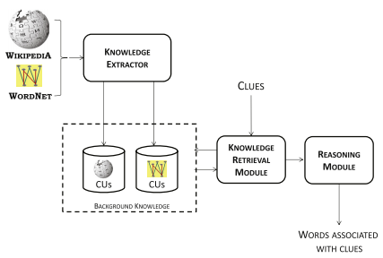
Existing System with Block Diagram

Slide 7
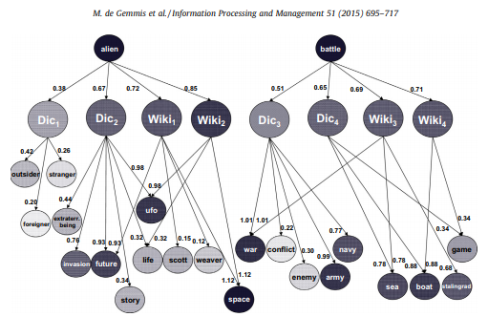
Existing System with Block Diagram

Slide 8
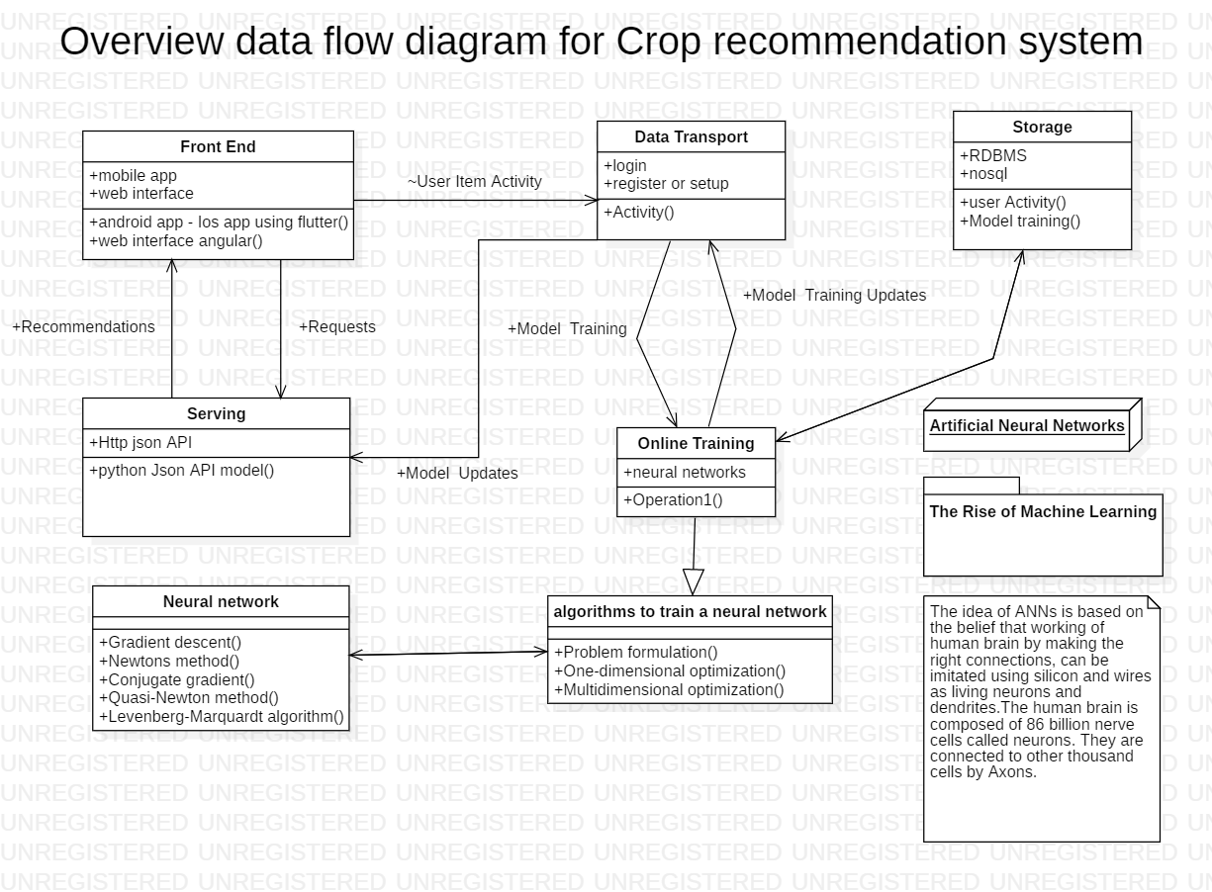
Proposed System with Block Diagram

Slide 9
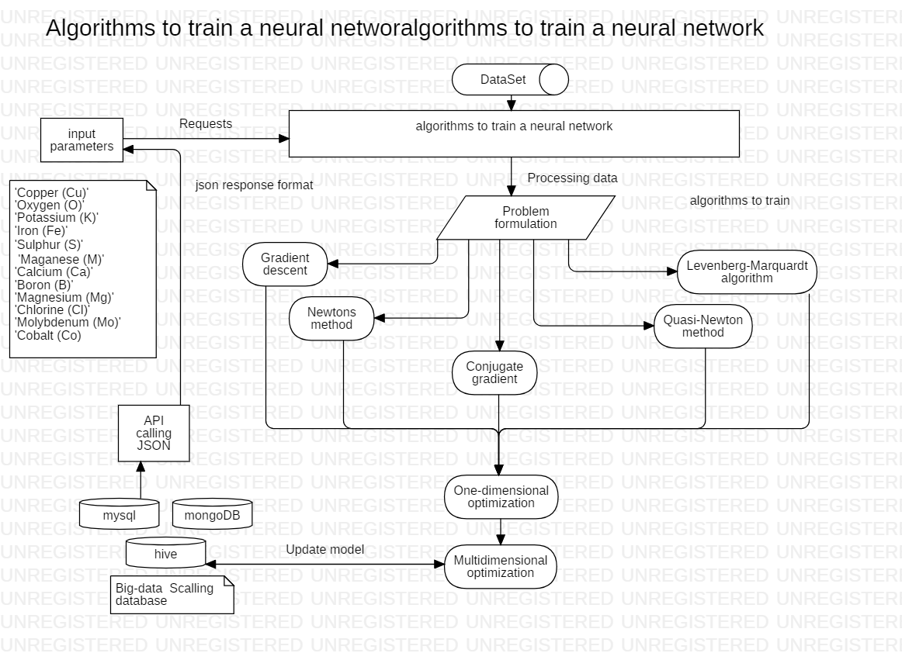

Slide 10
Module Description

Slide 11
MODULE DESCRIPTION
MODULE 1: Interaction Model
Developing all possible utterances, slot values and intents.
MODULE 2: Dynamic storage and Retrieval from DB
Database creation with table that will update itself dynamically (add and remove items).
MODULE 3: Building a neural network
Neural networks is built using various clusters considering all soil and crop factors as attributes.
MODULE 4: Tensor flow convolutional neural network
The tensor flow will provide the work model for the neural network that is the network will be evaluated based on some criteria and the criteria’s should be satisfied to get the result.
MODULE 5: Create API in python using flask
APIs are the tools for making information and application functionality accessible over the internet.

Slide 12
Software Hardware Requirements:
BM's one-stop cloud computing shop provides all the cloud solutions and IBM cloud tools
Environments
Define the hardware size and software configuration for the runtime associated with Watson Studio tools such as notebooks.
4 vCPU and 16 GB RAM

Slide 13
Data Set:
Open Government Data Platform (OGD) India is a single-point of access to Datasets/Apps in open format published by Ministries/Departments.
https://data.gov.in/
https://github.com/CreativeCrops/Review-II/blob/master/dataset_v2.csv

Slide 14
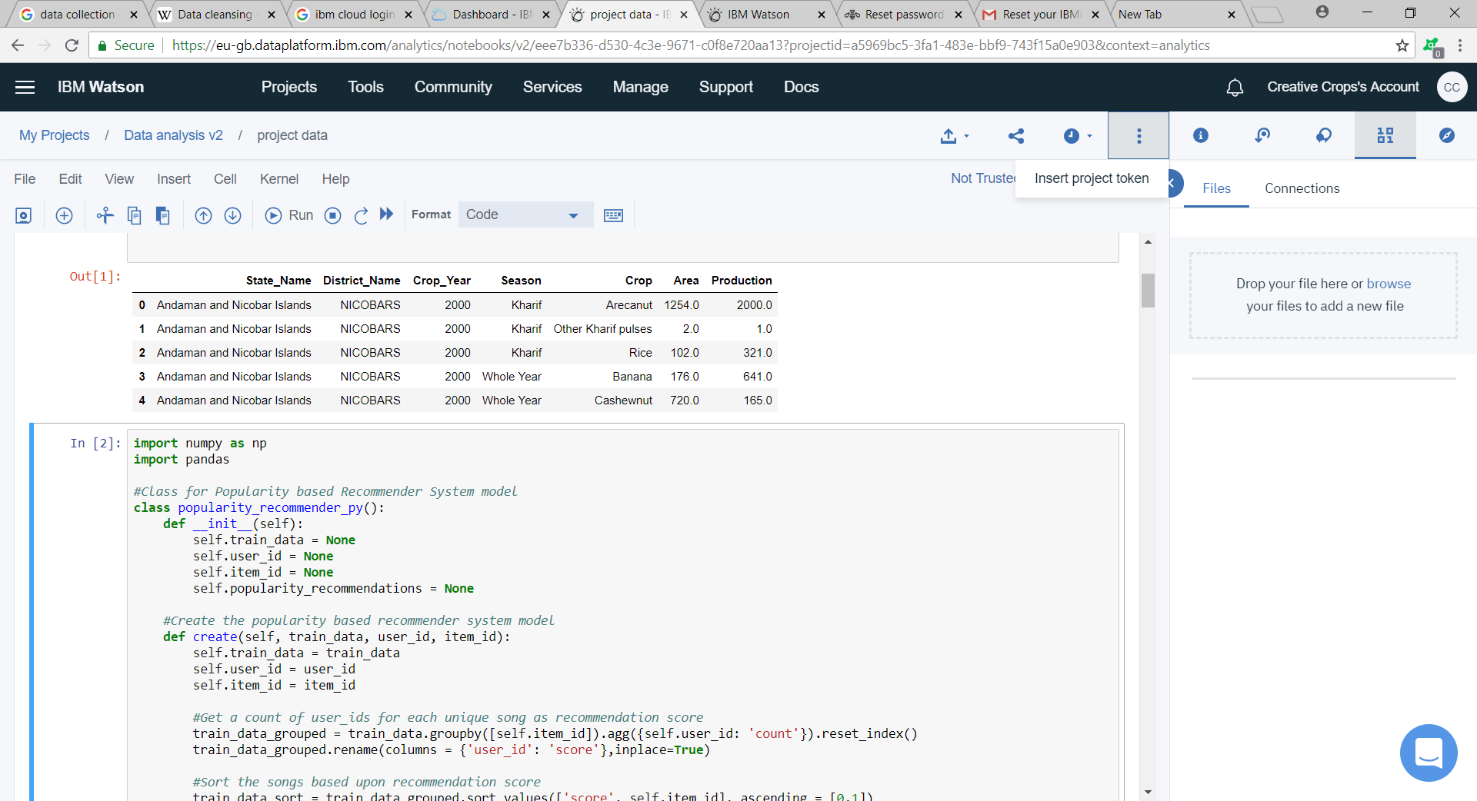
ScreenShots:

Slide 15
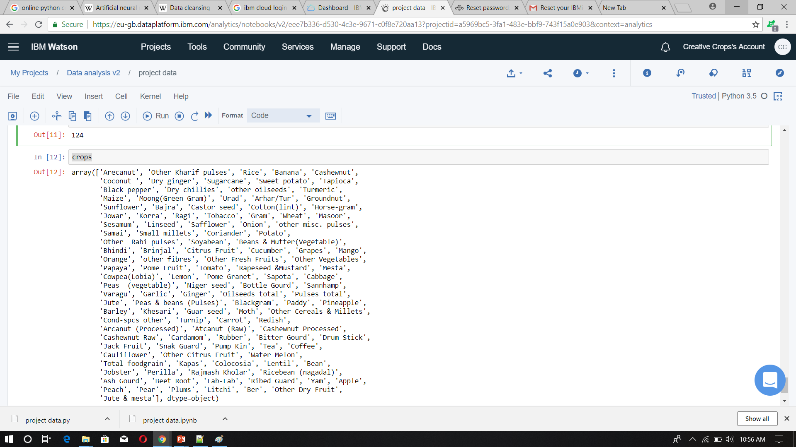

Slide 16
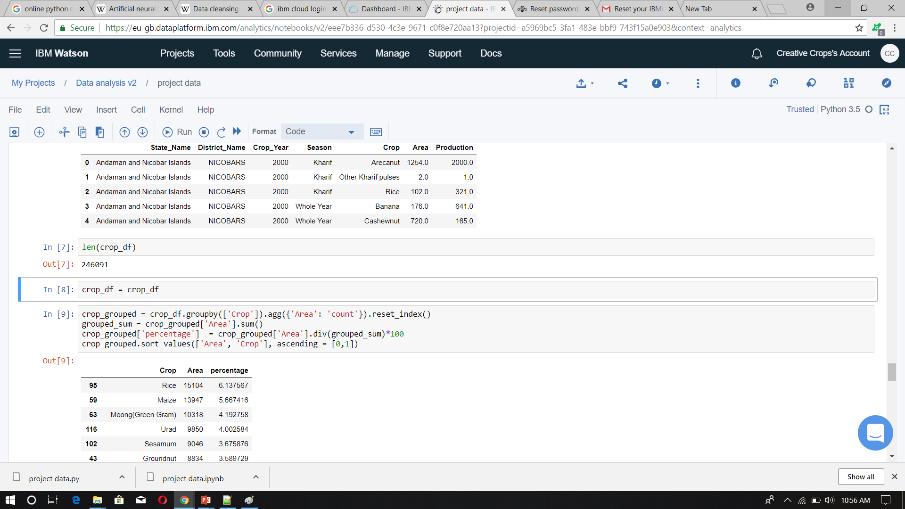

Slide 17


Slide 18


Slide 19


Slide 20
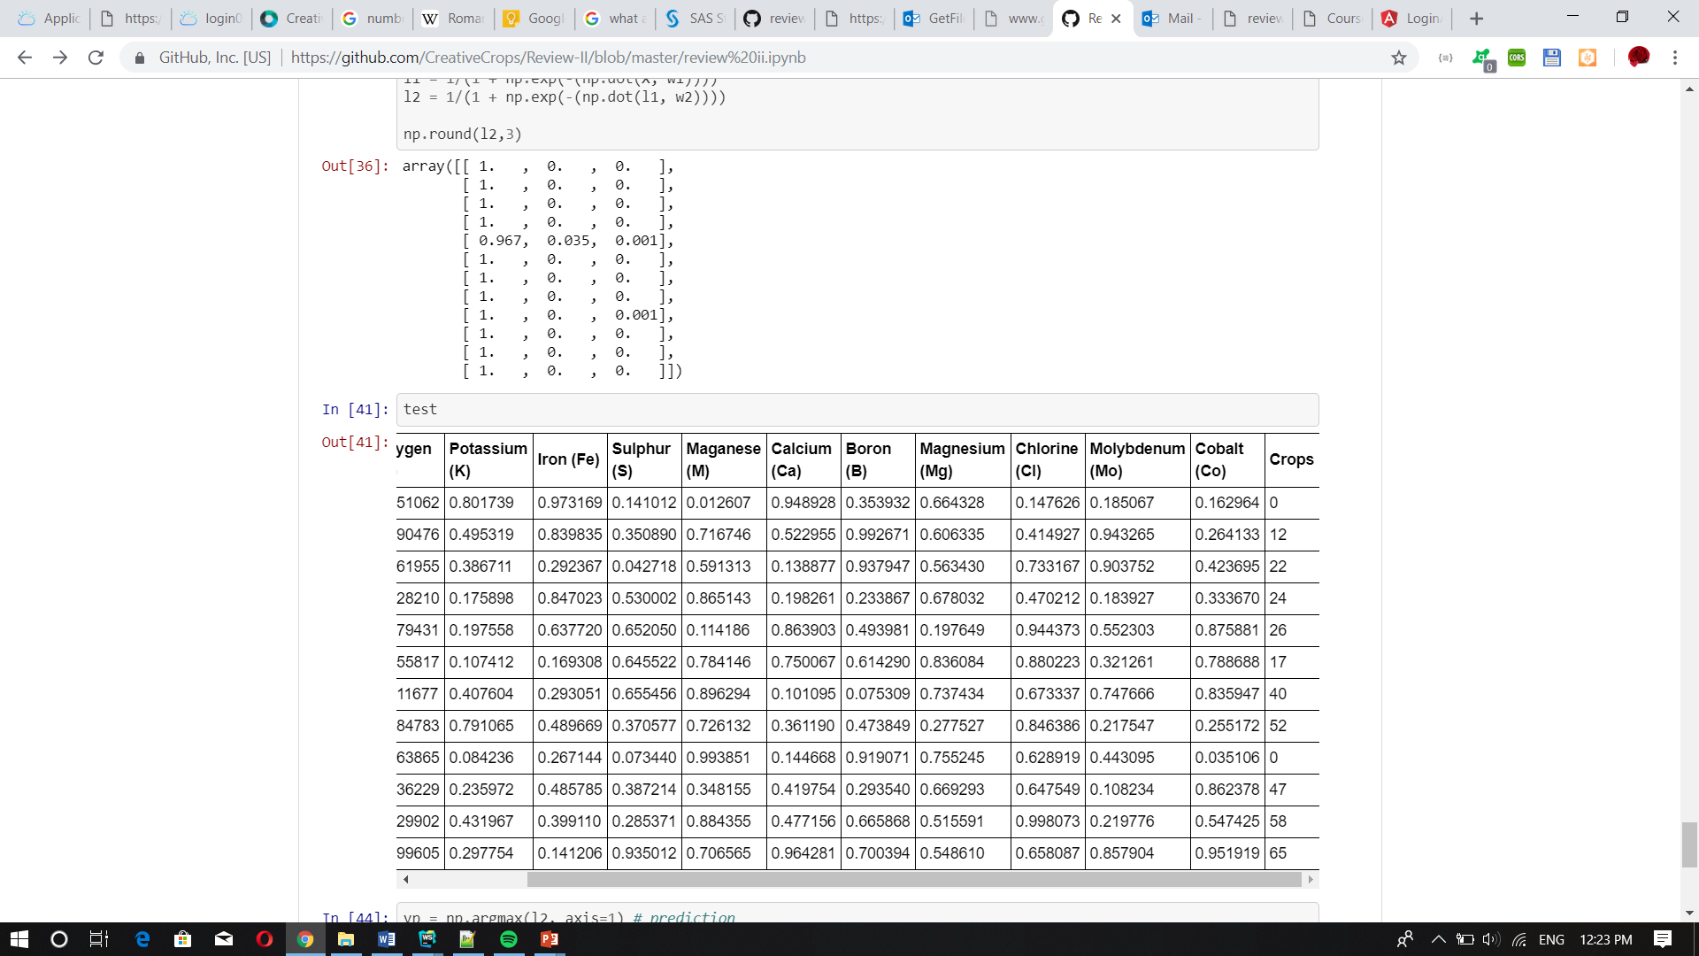

Slide 21


Slide 22
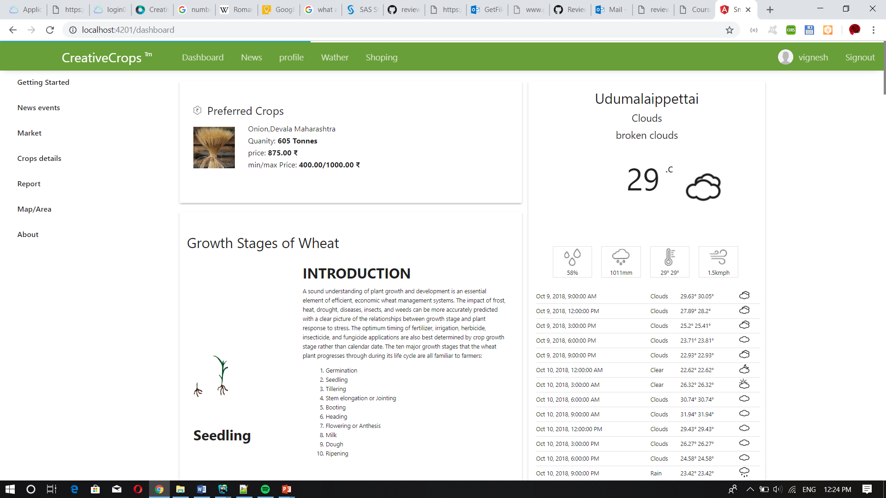

Slide 23
Future Work
User interface design
Web interface development
Mobile app development
testing AI with Test Case
Processing a Ai algorithm
testing and Debugging
deploy on cloud
 | 1-3 | 3-5 | 5-7 | 7-9 | 7-10 | 10-14 | 14-18 | 18-20 | 20-22
User interface design | *
Web interface development |  | * | *
Mobile app development |  |  |  | * | *
testing AI with Test Case |  |  |  |  |  | *
Processing a Ai algorithm |  |  |  |  |  |  | *
testing and Debugging |  |  |  |  |  |  |  | *
deploy on cloud |  |  |  |  |  |  |  |  | *

Slide 24
References
Aitkin, M. and Foxall, R. (2003). Statistical modelling of artificial neural networks using multi-layer perceptron. Statistics and Computing 13, 227–239.MathSciNetCrossRefGoogle Scholar
Alon, I., Qi, M. and Sadowski, R.J. (2001). Forecasting aggregate retail sales: a comparison of artificial neural networks and traditional methods. Journal of Retailer and Consumer Services 8, 147–156.CrossRefGoogle Scholar
Anders, U. and Korn, 0. (1999). Model selection in neural networks. Neural Networks 12, 309–323.CrossRefGoogle Scholar
Barat, C., Loaiza, H., Colle, E. and Lelandais, S. (2000). Neural and statistical classifiers. Can such approaches be complementary? In: Instrumentation and Measurement Technology Conference, Vol. 3, pp. 1480–1486.Google Scholar
Bastos Cavalcante, R. and Ludemir, T.B. (2001). Design of neural networks for time series prediction using case-initialized genetic algorithms. In: Proceedings 8th International Conference on Neural Information Processing, pp. 382–387.Google Scholar
Benediktsson, J.A. and Swain, P.H. (1990). Neural network approaches versus statistical methods in classification of multisource remote sensing data. IEEE Trans. on Geoscience and Remote Sensing 28 (4), 540–552.CrossRefGoogle Scholar

Slide 25
Bernier, J.L., Gonzalez, J., Canas, A. and Diaz, A.F. (2002). Evaluating the impact of multiplicative input perturbations on radial basis function networks. In: European Symposium on Artificial Neural Networks, pp. 237–244.Google Scholar
Bissessur, Y., Martin, E.B., Morris, A.J. and Kitson, P. (2000). Fault detection in hot steel rolling using neural networks and multivariate statistics. IEE Proc. Control Theory and Applications 147 (6), 633–640.CrossRefGoogle Scholar
Blough, D.K. and Anderson, K.K. (1994). A comparison of artificial neural networks and statistical analyses. Tech. Rep. Pacific Northwest National Laboratory, Richland, Washington, 1–38.CrossRefGoogle Scholar
Bouqata, B., Bensaid, A., Palliam, R. and Gómez Skarmeta, A.F. (2000). Time series prediction using crisp and fuzzy neural networks: a comparative study. In: Proceedings Conf. on Comp. Intelligence for Financial Engineering, pp. 170173.Google Scholar

Slide 26
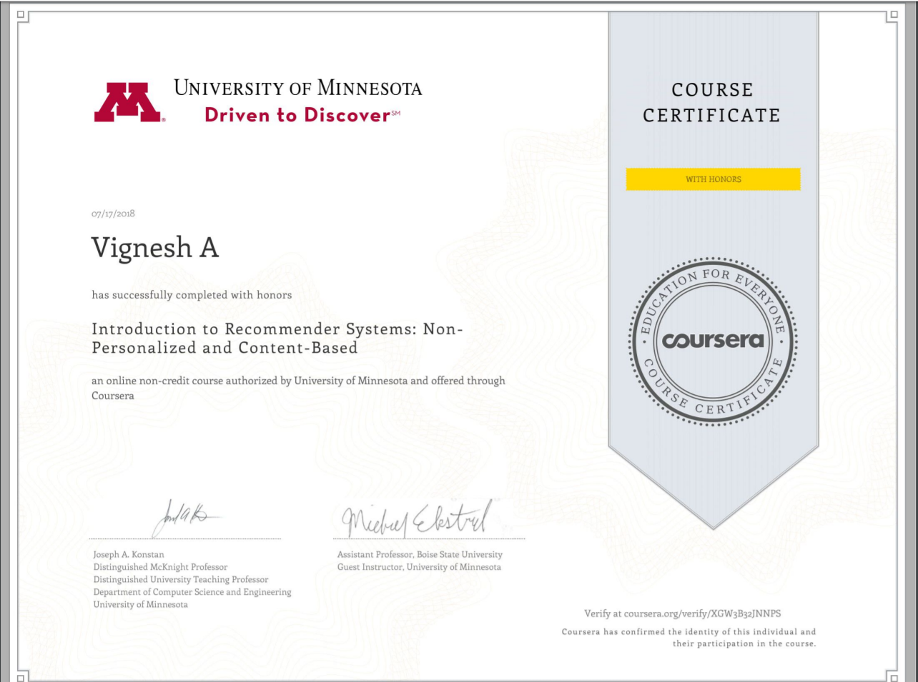
Online Certification Courses
VIGNESH A
Coursera - Introduction to Recommender Systems Non Personalized and Content Based - University of Minnesota

Slide 27
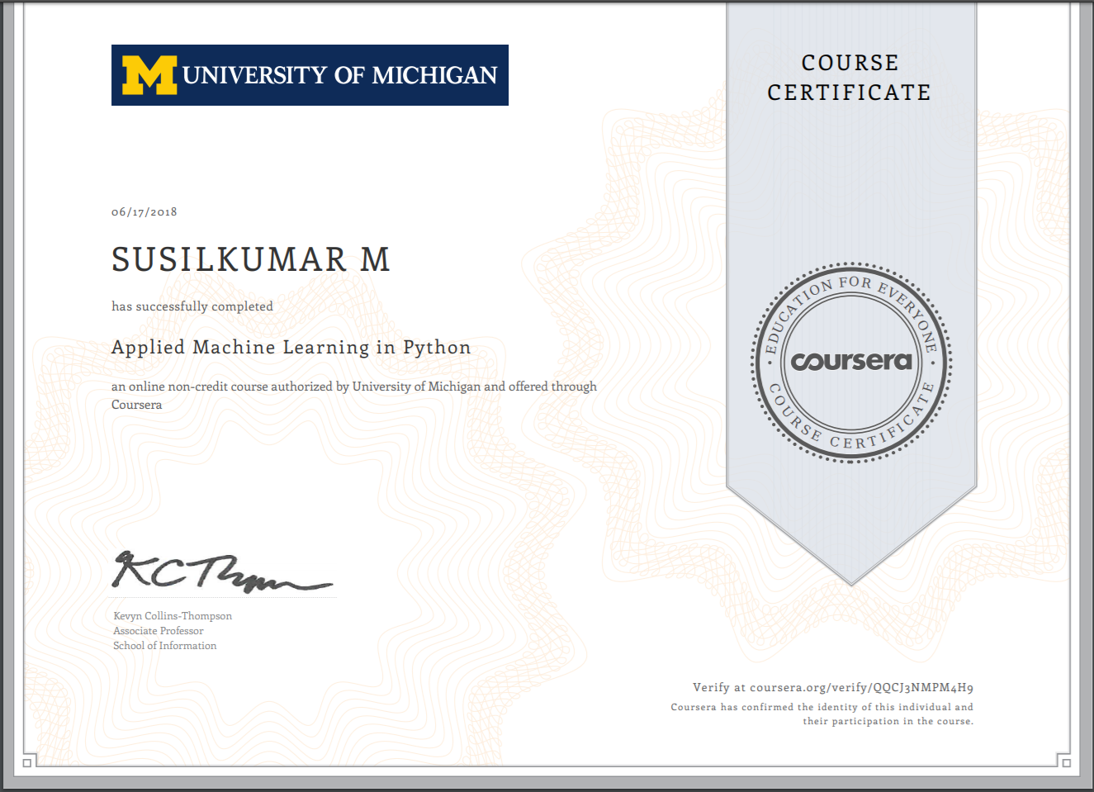
Online Certification Courses
SUSILKUMAR M
Applied Machine Learning in Python

Slide 28
THANK YOU

Slide 30
Live Coding and demo
https://github.com/CreativeCrops/Review-II/blob/master/review%20ii.ipynb

